Slide 1



*Ready-to-Use
Presentation
Own Your Limits Responsible Drinking Campaign
*Date:
Last Updated: October 2023

Slide 2
Presentation guide
The following ready-to-use presentation slides offer a high-level overview of the Own Your Limits campaign. This presentation is specifically designed for professionals to present to a professional audience, such as military treatment facility staff, Unit Prevention Leaders, Drug and Alcohol Program Advisors (DAPAs), and others who have interest in learning about the campaign and its resources.
Throughout this deck you’ll find highlighted sections for users to personalize and add relevant local information. Be sure to also update the cover page title and *footers for your use.
If you are presenting and would like a more in-depth background of all information and resources related to Own Your Limits, it may be helpful to review the following materials beforehand:
  Own Your Limits Campaign Toolkit
  Own Your Limits Campaign Overview Video
Looking for additional information or have questions? Please email the team: dha.ncr.comm.mbx.drink-responsibly@health.mil
Remove this slide for use

Slide 3
Table of Contents
Own your limits overview
03
Campaign resources
08
“The views expressed in this presentation are those of the author and do not necessarily reflect the official policy or position of the Department of Defense, nor the U.S. Government.”
Notes:
Today we will be going through some information about the DoD’s Own Your Limits responsible drinking campaign and its available resources.
DISCLAIMER: The views expressed in this presentation are my own and do not necessarily reflect that of the DoD or the government.

Slide 4
Own your limits overview www.ownyourlimits.org

Slide 5
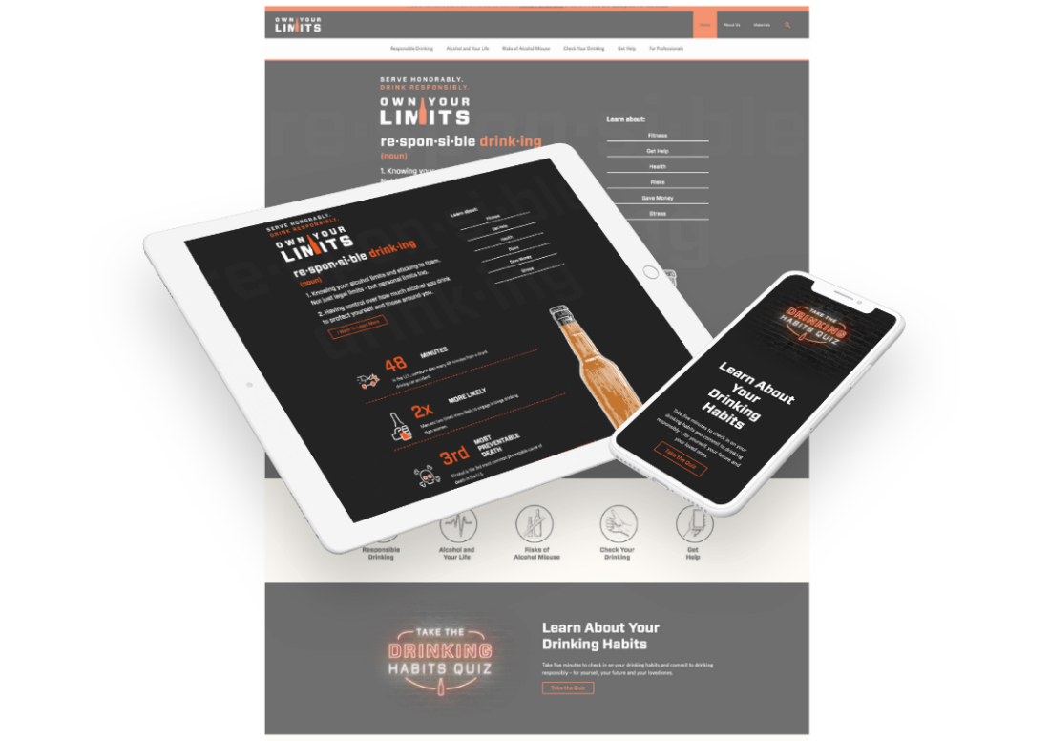
About own your limits
Own Your Limits is a DoD education campaign, aligned to the Defense Health Agency, developed to help Service members learn how to drink responsibly if they choose to drink alcohol
DoD launched this campaign in September 2019
  It replaced the DoD’s That Guy responsible drinking campaign
Notes:
Some background on Own Your Limits here. Own Your Limits is the DoD’s responsible drinking campaign. It was launched in 2019 to replace the DoD’s retired campaign That Guy/That Girl. It was developed to help Service members learn how to drink responsibly if they choose to drink alcohol. The campaign’s goals are to:
Give Service members the information and motivation they need to make responsible choices when drinking alcohol, which includes sticking to safe and moderate drinking limits
Support professionals in their mission to educate Service members on the importance of drinking alcohol responsibly
Includes MTF staff, command drug and alcohol program advisors (DAPAs), alcohol and drug control officers (ADCOs), as well as substance abuse professionals, drug demand reduction program managers, and others
Support friends and family of Service members with the information and resources they need to talk to their Service member about alcohol use concerns

Slide 6
Why is responsible drinking important?
Alcohol misuse threatens military readiness and discipline, and the mental and physical resilience of Service members
Service members face unique challenges including deployment, combat, and increased stress–all of which may lead them to turn to alcohol to cope.
Some Service members may just enjoy drinking alcohol
Excessive drinking may result in ^{1,2}:
  Loss of productivity
  Engagement in risky behaviors like unsafe sex and drinking and driving
  Decreased reaction time and decision-making
  Impaired judgement
  Reduced cognitive and motor skills
Notes:
So why is it important to promote responsible drinking? We know that alcohol misuse, in this case, excessive drinking, threatens military readiness, discipline, and resilience. Service members are exposed to unique challenges such as deployment, combat, time away from family, and generally increased stress that may cause them to turn to alcohol to cope. Some Service members may just enjoy drinking. Whatever the initial reason for drinking, we know that excessive drinking can lead to loss of productivity, risky behaviors like unsafe sex and drinking and driving, decreased reaction time and decision making, impaired judgement, and reduced cognitive and motor skills.

Slide 7
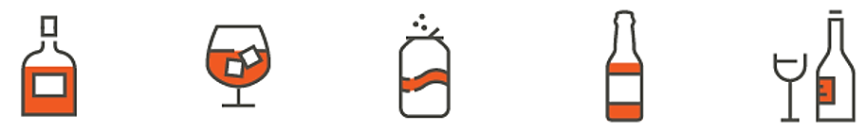
Safe and moderate drinking limits
What factors can impact someone’s drinking limits? ³
Physical condition like weight or fitness level
Gender, race, and age
Amount of food and water consumed
Medication use
Family history of alcohol use
What is moderate drinking? ⁴
For women: up to 1 or fewer drinks per day or 7 drinks per week
For men: up to 2 or fewer drinks per day or 14 drinks per week
Notes:
When Own Your Limits mentions “responsible drinking,” it means safe and moderate drinking limits. Many different factors can impact someone’s drinking limits. They may include physical condition like weight or fitness level, gender, race, and age, the amount of food and water consumed that day, someone’s medication use, and a family history of alcohol use. So, the limits differ for everyone based on these factors.
Moderate drinking differs between women and men. For women, moderate drinking is up to 1 or fewer drinks per day or 7 drinks per week. For men, moderate drinking is up to 2 drinks per day or 14 drinks per week.

Slide 8

Own Your limits Meets service members where they are
Own Your Limits supports the DoD’s efforts to build and sustain a ready and resilient force by providing resources and information to Service members so they can serve honorably and drink responsibly
Although Own Your Limit’s target audience is 18-24-year-old enlisted Service members, the campaign is a resource for all Service members regardless of age, rank, Component, or Service branch
Own Your Limits is established in a .org web space due to topic sensitivity. Service members can access the site on any device 24/7
The campaign is not a TRICARE® program and is not tied to TRICARE benefits – the resources are available to all Service members as well as professionals, family, and friends
Notes:
The campaign was created to meet Service members where they are. It supports the DoD’s efforts to build and sustain a ready and resilient force by providing resources and information to Service members so they can serve honorably and drink responsibly. Own Your Limits’ primary target audience is 18 to 24 enlisted Service members (they have the highest rates of alcohol misuse), but the campaign’s resources can be utilized by all Service members regardless of age, rank, component, or Service branch. The Own Your Limits website is established in a .org webspace instead of .mil due to topic sensitivity and anyone can access the site on any device 24/7. The campaign resources are available to all Service members, professionals, family, and friends – it is not a TRICARE program and is not tied to TRICARE benefits.

Slide 9
Campaign resources

Slide 10
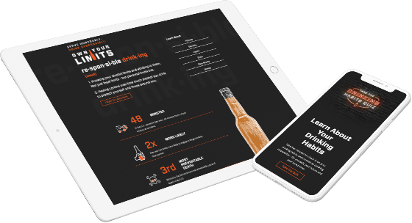
Campaign Website sections
Responsible Drinking. Find information on standard drink sizes, binge drinking, tips for cutting back, drinking consequences, and drinking myths
Alcohol and Your Life. Find articles on how alcohol can impact physical, financial, psychological, and social health
Risks of Alcohol Misuse. Learn about the short- and long-term effects of alcohol, drunk driving, and alcohol poisoning
Check Your Drinking. Find interactive tools to check drinking habits including a drinking habits quiz, a drink size calculator, and alcohol calorie counter
Get Help. Find articles about addressing alcohol use concerns and where to find help
Notes:
There are numerous ways that professionals can use the Own Your Limits campaign to support their efforts in educating Service members about responsible drinking. There is actually a dedicated For Professionals section of the Own Your Limits website where professionals like yourselves can find resources.
In that section, you’ll find the Own Your Limits Campaign Toolkit, a one-stop-shop for all things related to the campaign. You can subscribe to The Buzz on Responsible Drinking e-newsletter to get quarterly updates on the campaign and valuable resources sent directly to your inbox. Take advantage of the campaign’s free bulk print and promotional materials to get free campaign materials sent directly to you at your installation or command. Use the ready-to-use messaging available for your next plan of the month/day/week notes, newsletters, or emails. You can also link to the campaign on your website using the available graphics and HTML code.

Slide 11
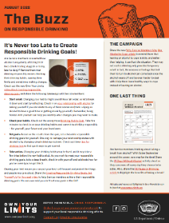
Using Own your limits as a professional
Check out resources in the For Professionals section of the website
Review the Campaign Toolkit, a one-stop-shop for all things related to the Own Your Limits campaign
Subscribe to The Buzz on Responsible Drinking e-Newsletter
  Visit ownyourlimits.org and click “Contact Us” in the bottom right-hand corner to send the campaign a message. Select “Sign up for our e-Newsletter” as subject
Order free bulk print and promotional materials
Use ready-to-use messaging in your next POM/POD/POW, newsletter, or email
Link to us on your website using the available graphics and HTML code
Notes:
There are numerous ways that professionals can use the Own Your Limits campaign to support their efforts in educating Service members about responsible drinking. There is actually a dedicated For Professionals section of the Own Your Limits website where professionals like yourselves can find resources.
In that section, you’ll find the Own Your Limits Campaign Toolkit, a one-stop-shop for all things related to the campaign. You can subscribe to The Buzz on Responsible Drinking e-newsletter to get quarterly updates on the campaign and valuable resources sent directly to your inbox. Take advantage of the campaign’s free bulk print and promotional materials to get free campaign materials sent directly to you at your installation or command. Use the ready-to-use messaging available for your next plan of the month/day/week notes, newsletters, or emails. You can also link to the campaign on your website using the available graphics and HTML code.

Slide 12
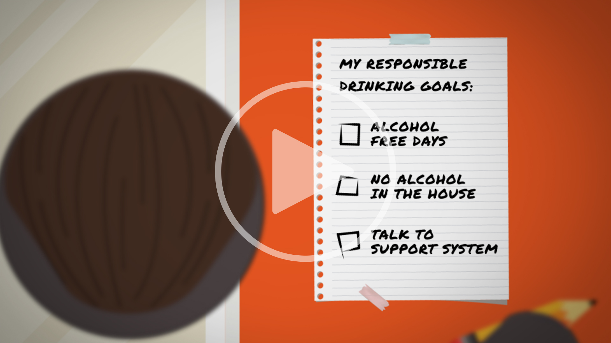
Campaign Videos
Stream or download videos including the Campaign Overview Video, How Alcohol Affects Your Brain and Body, and Creating Responsible Drinking Goals: Set Yourself Up for Success!
Notes:
Professionals can also stream or download any of the Own Your Limits videos including the Campaign Overview Video which offers an introduction to the campaign, a video that describes How Alcohol Affects Your Brain and Body, and the campaign’s newest video which we’ll watch here, Creating Responsible Drinking Goals: Set Yourself Up for Success! (HIT PLAY IF YOUR SYTEM ALLOWS)

Slide 13
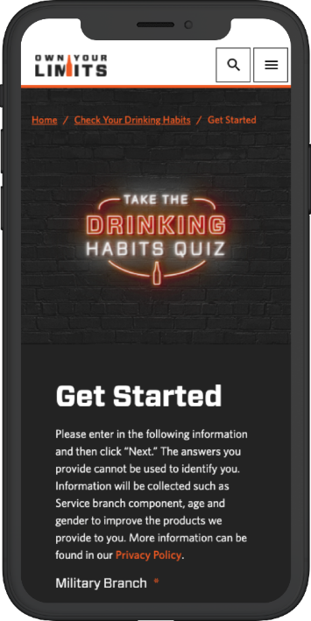
Resources for service members
The Drinking Habits Quiz: Based on the AUDIT-C, this anonymous quiz allows Service members to check their drinking habits and commit to drinking responsibly
Notes:
Under the Check Your Drinking section of the website that I mentioned earlier, you’ll find the Drinking Habits Quiz. This completely anonymous quiz, which is based on the AUDIT-C, offers Service members the opportunity to check their drinking habits in less than 5 minutes and then commit to drinking responsibly.

Slide 14
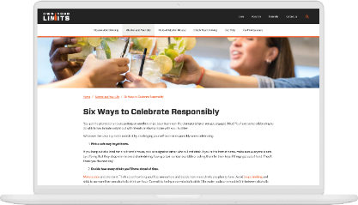
Resources for service members (Continued)
Web articles featuring a variety of resources about how to drink responsibly, the risks of alcohol misuse, and ways to check your drinking such as:
Bust Drinking Myths: Provides facts about alcohol so Service members can make informed choices if they choose to drink
Long-Term Effects of Alcohol: Highlights some of the serious long-term health impacts caused by drinking alcohol
Six Ways to Celebrate Responsibly: Gives Service members advice on how to drink alcohol responsibly when celebrating
Notes:
Professionals can also utilize and share any of the available web articles on the Own Your Limits website. Find articles like Bust Drinking Myths, which provide facts about alcohol so Service members can make informed choices if they choose to drink; Long-Term Effects of Alcohol, which highlights some of the serious long-term health impacts caused by drinking; or Six Ways to Celebrate Responsibly, which offers advice on how to drink responsibly when celebrating.

Slide 15
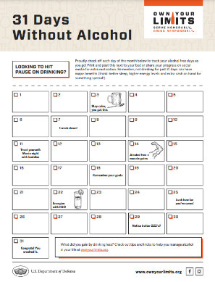
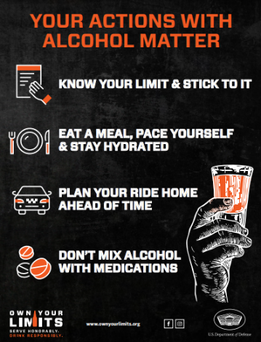
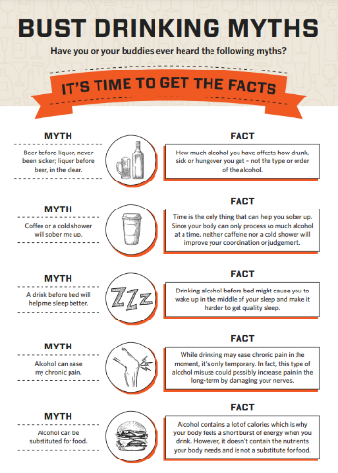
Downloadable Resources
Own Your Limits has many downloadable resources that offer helpful information on how to drink responsibly and how to identify alcohol use concerns such as:
Poster Link
Fact Sheet Link
Activity Sheet Link
Notes:
Professionals can also view/print/disseminate any of the Own Your Limits downloadable resources (posters, activity sheets, and fact sheets), many of which are also available for the free bulk ordering I mentioned earlier. These three materials here are examples of the many pieces available.

Slide 16
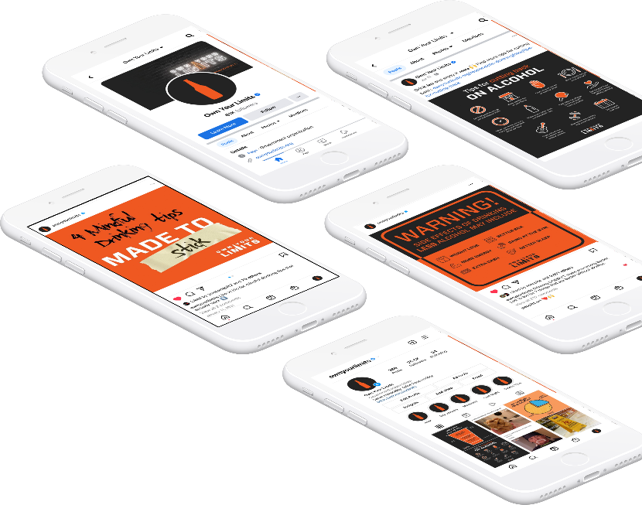


own your limits on Social Media
  Features engaging graphics and resources to equip Service members with responsible drinking tips, encouragement, and information that can empower them to rethink the way they incorporate alcohol in their life, if they choose to drink
  Find Own Your Limits on Facebook and Instagram
Notes:
Own Your Limits is also on social media. The pages on Facebook and Instagram feature engaging graphics and resources that equip Service members with responsible drinking tips, encouragement, and information that can empower them to rethink the way they incorporate alcohol in their life if they do choose to drink.

Slide 17
Local Information
**Use this slide to add relevant local contact information for programs and POCs such as Alcohol and Drug Abuse Prevention Treatment (ADAPT), DAPAs, etc., news, and updates below:
News
Updates
**Remove for use

Slide 18
Contact The Own Your Limits Team
Let the team know how you’re using the campaigns to work with Service members at your installations!
Email: dha.ncr.comm.mbx.drink-responsibly@health.mil
Notes:
The Own Your Limits team wouldn’t be successful without the feedback and collaboration they have with the Services and professionals. They want to hear from you to understand how you may be using the campaigns to work with Service members. Please reach out to them with any questions, requests for information, or new ideas for specific resources.

Slide 19
References
1 https://www.cdc.gov/alcohol/fact-sheets/binge-drinking.htm
2 https://www.cdc.gov/vitalsigns/pdf/2011-10-vitalsigns.pdf
3 https://www.ownyourlimits.org/risks-of-alcohol-misuse/effects-of-alcohol/what-does-alcohol-do/
4 https://www.niaaa.nih.gov/alcohol-health/overview-alcohol-consumption/moderate-binge-drinking

Slide 20


Closing slide
Visit us
www.ownyourlimits.org
Check out our other campaigns
www.ycq2.org
www.toomuchtolose.org

